Slide 1

VIGILANT
Accident detection system.
Sonia. Maharshi. Shanthi. Aswin.

Slide 2

Introduction:
Road accidents rates are very high nowadays, especially two wheelers. Timely medical aid can help in saving lives. This system aims to alert the nearby medical center about the accident to provide immediate medical aid.
The accelerometer in the phones senses any sudden impacts or forces caused by an accident. Thus the the Android application in the mobile phone will send text messages to the nearest medical center and friends for help.

Slide 3
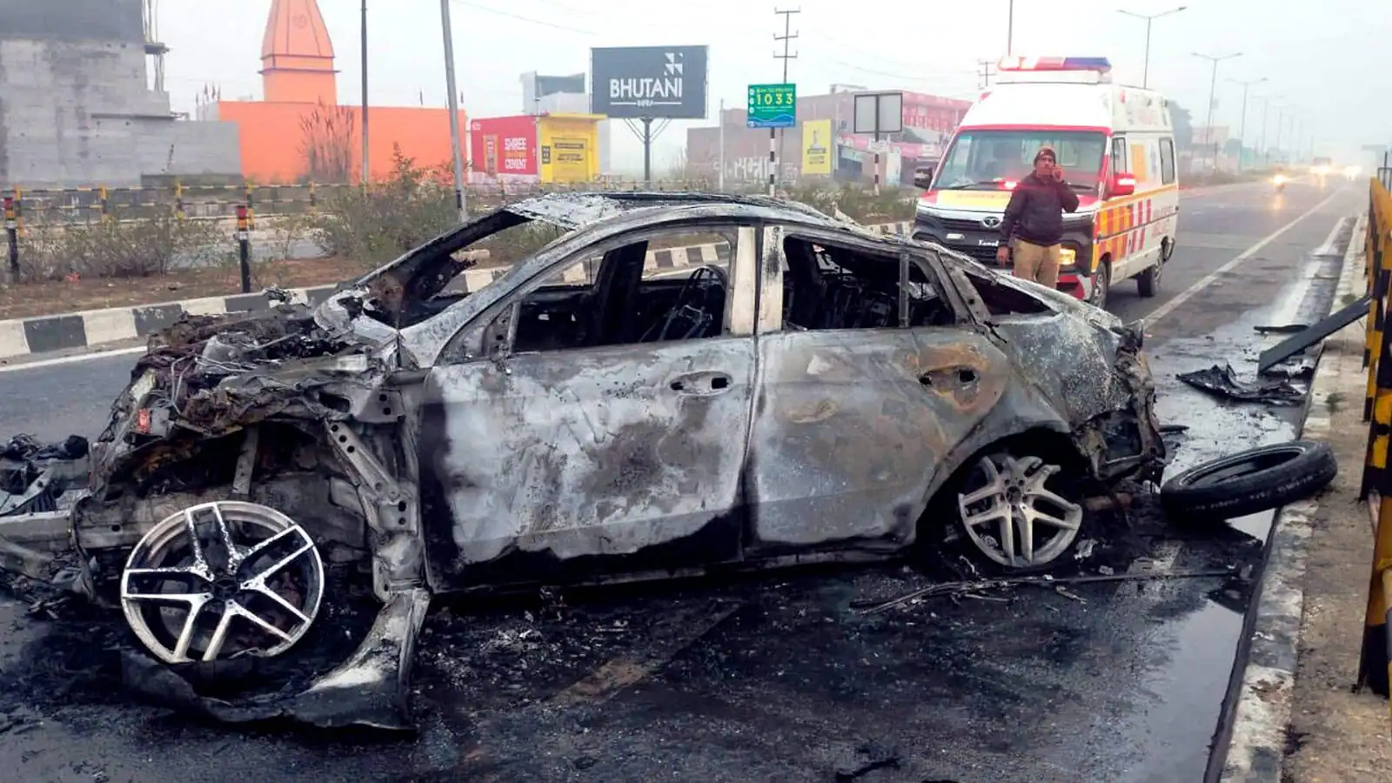
Problem statement
Just in the year 2021 , 4,12,432 road accidents happened in our country and out of which 1,53,972 people lost their lives.
A major reason for the deaths is unattended or late treatment availability.
Factors reason for this are mostly people’s hesitation for calling help, or the absence of a helping hand.
In a situation where each and every passing minute is of very importance, it is very important to have a proper system to let the emergency workers and police force to know about the incident resulting in a more and efficient way to save multiple lives.

Slide 4
Solution
The solution that we offer is named as “VIGILANT”.
An Android application which makes use of accelerometer in the mobile phones to detect any huge impact or force acting on someone which is normally caused during an accident.
Once such an incident is triggered, the App will start a timer of 10 sec for the user to cancel the actions if its caused not by a serious threat.
If not cancelled, the App will send SMS to the emergency services, family/friends and will fetch the aid needed by sharing informations such as the GPS location,time etc.

Slide 5


Tech Stack
The tech stack used to create the Android app is a low code solution called SketchWare.
Sketchware helps us to access the native functionality of the android devices easily.
While the Sketchware is low code, but the app gets compiled into JAVA.
Using Firebase we also implement a cloud database for storing essential data.

Slide 6
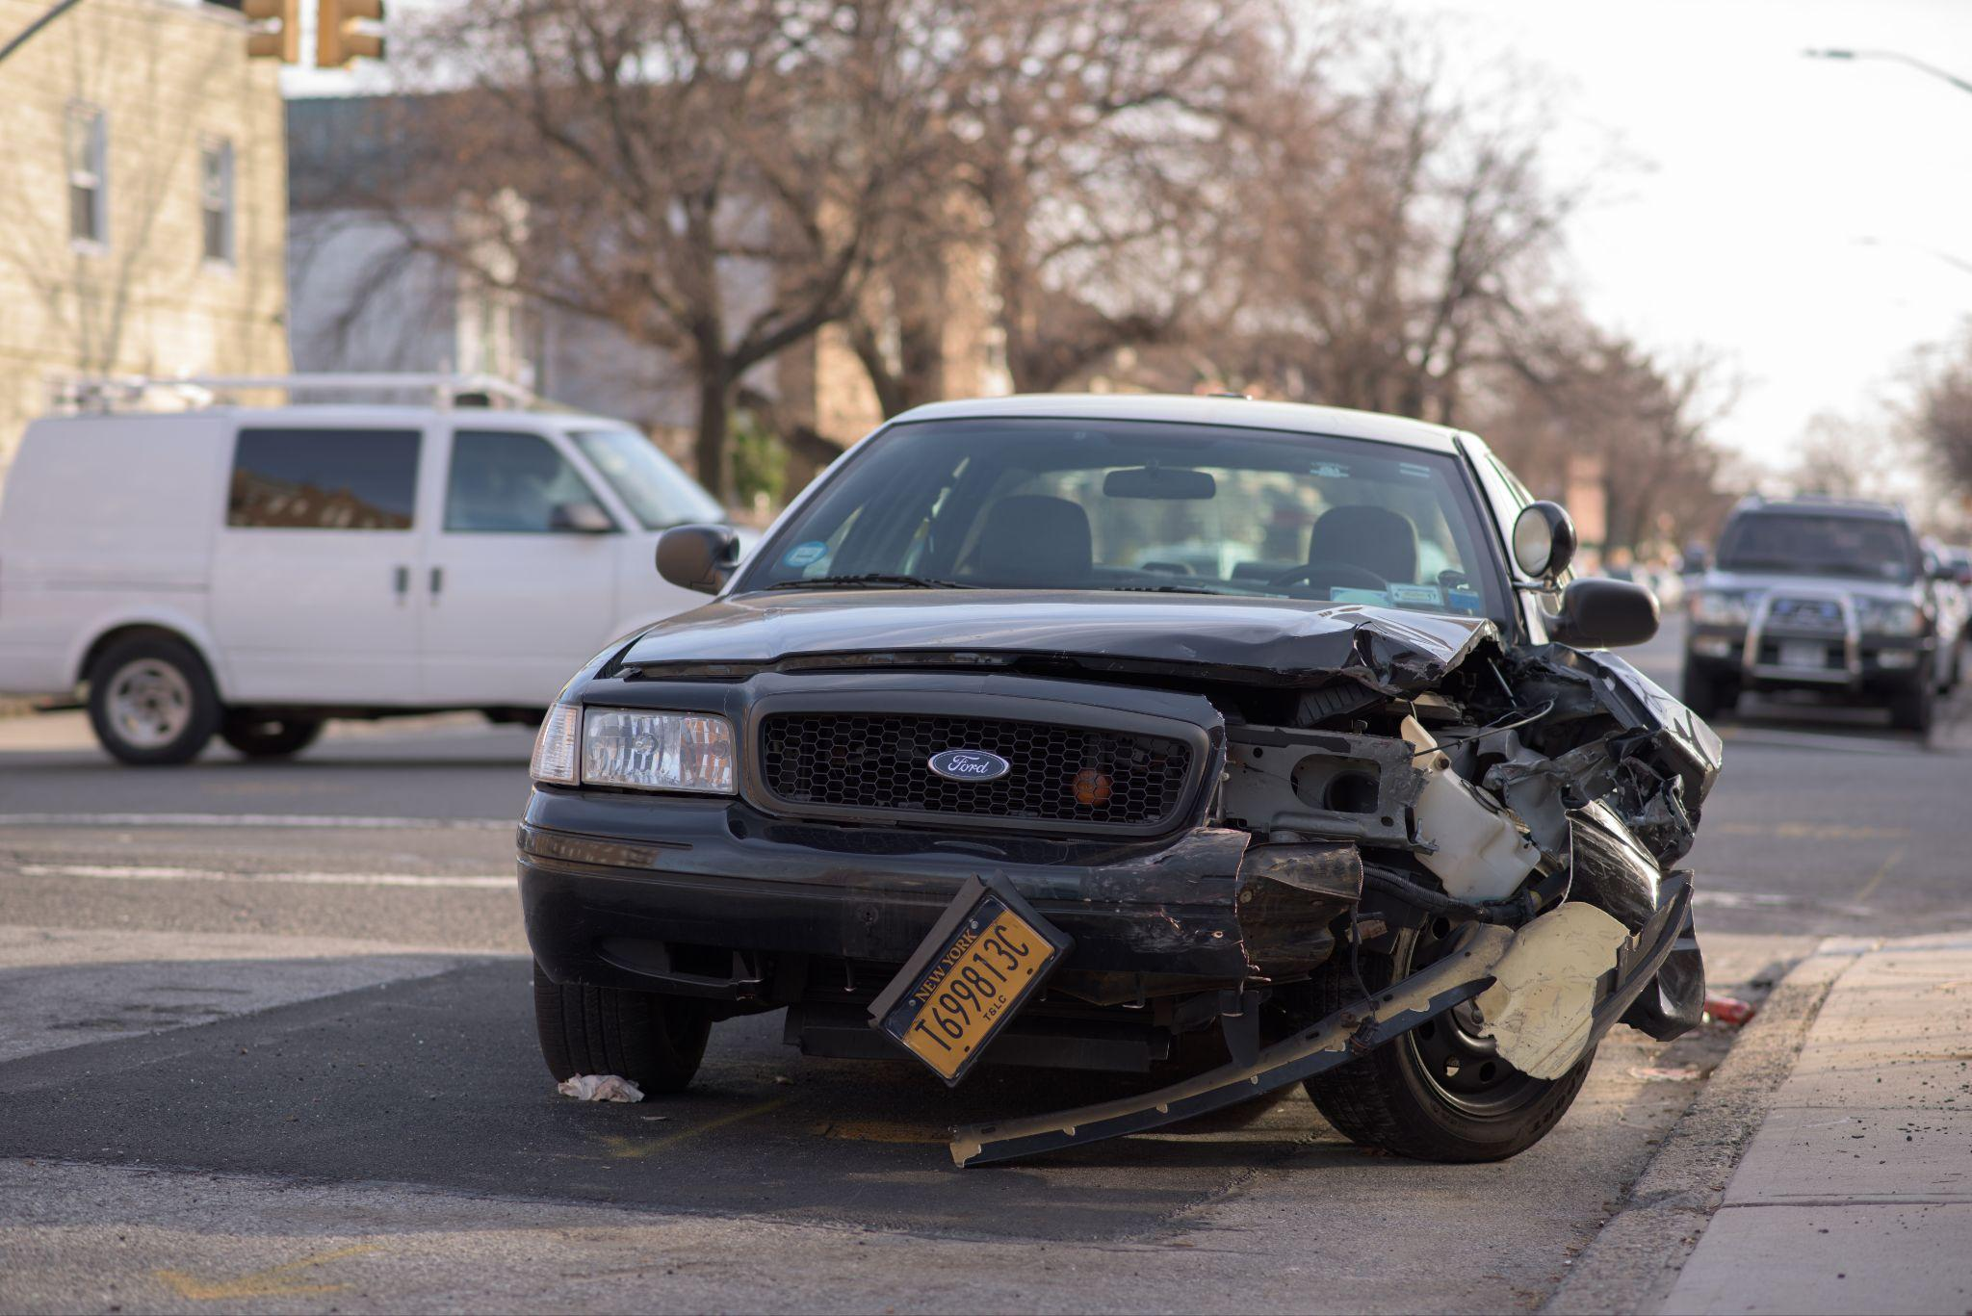
Implementation and Scopes of accident detection system:
The applications that people will download from the source will be implemented in their device for detection of any severe accident that could cause while driving.
Such detection system will be using accelerometer that measure acceleration, which is the rate of change of velocity of an object .
The detection system will detect the motor vehicle accident by sudden collision impact from other vehicles or obstacles. It will check whether the collision was above it’s limited range then it will forward SMS and GPS to the victim’s contacts.

Slide 7

Social impact on Safety in transportations
Reduced Stress and Anxiety:
.Safer transportation systems reduce stress and anxiety related to travel.
Education and Awareness:
.Road safety initiatives often involve education and awareness campaign.
Improved Quality of Life:
.Safe transportation systems enhance the
quality of life for individuals and communities.

